Slide 1
Assignment – Types of Machine Learning
Submitted By: Pooran Pragnya
November Batch (BDS)

Slide 2
1. Feature and Label
Features: These are descriptive attributes or simply we can say that they are characteristics of observation.
Features are defined as individual independent variables that act as input.
Label: These are referred as output.
The output classes can also be considered as labels.
These are Dependent varisbles.
Note: Features and Labels applies to both classification and Regression Problems.

Slide 3
2. Training Set and Testing Set
Training set: It is a set implemented in a dataset to build up a model .
Training data is the set of the data on which the actual training takes place.
Testing Set: The test set informs us about the final accuracy of the model after completing the training phase.
ML is about using data to train a model.

Slide 4
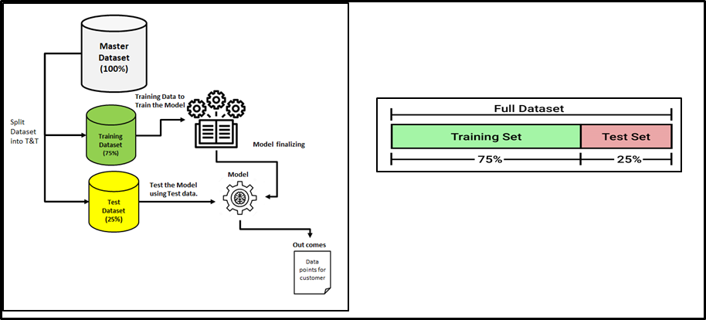

Slide 5
3.Different Types of Machine Leaning:
1. Supervised Learning
2. Unsupervised Learning
3. Reinforcement Learning

Slide 6
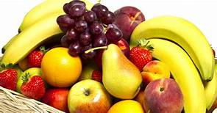
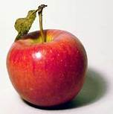
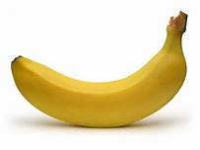
Supervised Learning
Supervised Learning: In this type of Machin learning, labeled data is provided to train a model, which means some data is already tagged with the correct answer. After that a machine is provided with new set of examples (data) so that the supervised learning algorithm analysis the training data and produces the correct outcome from the labelled data.
Example:

Slide 7
Unsupervised Learning
It is training of machine using information that is neither classified nor labelled and allowing the algorithm to act on that information without guidance
Here the task of machine is to group unsorted information according to similarities, patterns and difference without any prior training of data
Here, output is unknown (unlike in supervised learning were output was known)
Example: Classification of spam and not-spam based on the subject.

Slide 8
4.Reinforcement Learning
It is about taking suitable action to maximize reward in particular situation.
It is an area of machine learning concerned with how –intelligent agents ought to take actions in an environment in order to maximize the notion of Cumulative reward.
No Labelled Data will be provided here, based on experience the agent is bound to learn.
It is Based on hit and trial process.

Slide 9
5. Difference Between Supervised and Unsupervised Learning
Supervised Learning | Unsupervised Learning
It can be used for two different types of problems i.e for regression and classification problems | It can be used for two different types of problems i.e for clustering and association problems.
Input data along with output data is provided | Here only Input is provided
Accurate results are produced here | They are not so accurate as compared to supervised learning
Labelled data is used to train supervised learning | Un-labelled data is used as input.
Output is predicted here | Hidden patterns in the data can be found here.
Training the model to predict output when a new data is provided is the objective of supervised learning | Finding useful insights, hidden patterns from the unknown dataset is the objective of unsupervised learning

Slide 10
6. Types of Supervised Learning
1. Classification: A classification problem is when the output variable is a category such as “Red”, “Disease” etc.
It is used to produce discrete data (i.e not a numerical value) into specific categories
Example: If a person has cancer or not, email is spam or not etc.
Classification models are used for problems where the output variable can be categorised such as “Yes” or “No” or “Pass” or “Fail” etc.

Slide 11
2. Regression : A regression problem is when the output variable is a real value such as “Dollars” or weight etc,
It is used when dealing with the continuous data
It predicts a numerical value.
Types of models for classification and Regression:
1. Linear Regression
2. Polynomial Regression
3.Support Vector Machine (SVM)
4.Decision Tree
5. Random Forest Regression
6 Naive Bayes
* Logistic Regression is used for classification problems only.

Slide 12
Types of Unsupervised Learning
Clustering: It is collection or organizing of similar data items called clusters. The primary goal here is to find similarities in the data points and grouping similar data points into a cluster.
It is most common method used for unsupervised learning.
It finds various application in Anomaly detection, Visualization, Finding association rule etc.

